Slide 1
SHORE TEMPLE
MAMALLAPURAM

Slide 2
Location: | Mahabalipuram, Tamil Nadu
Built in: | 7th century
Dedicated to: | Lord Shiva and Lord vishnu
Attraction: | One of the earliest structural temples in South India
Significance: | Listed as World Heritage Site
How to reach: | One can easily reach Shore Temple by taking regular Buses or by hiring Taxis from anywhere in Tamil Nadu

Slide 3
Built at 7th century AD
Overlooks the shore of BAY OF BENGAL
Later Narasimha Varman II, (Rajasimha) completed the skilled work in his rule.
Built with blocks of granite.
There were seven magnificent temples what are known as the seven PAGODAS.
Oldest south indian temple.
Constructed in the nature Dravidian style.

Slide 4
It has been listed among the world heritage sites of the UNESCO.
The temple is full of designs made by carvings.
There are three temples.
two Shiva Temples face east and west respectively.
The other one is the Vishnu Temple.
The Vishnu temples were built by Narasimha Varman I
The other two were built by Narasimha Varman.

Slide 5
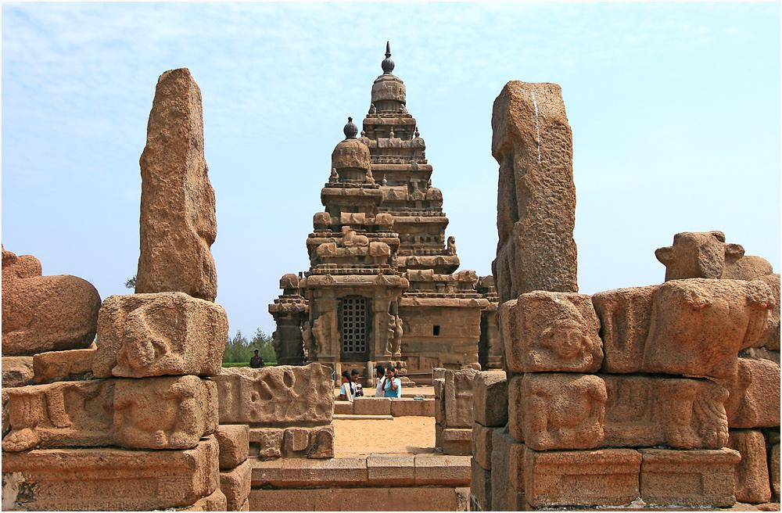
One can find the beautifully carved twin Dwarka Palaks (gate keepers) at the entrance of the east facing Shiva Temples.

Slide 6
On both sides of the temple inside are the marvelous sculptures of Lord Brahma and Lord Vishnu with their better halves.

Slide 7
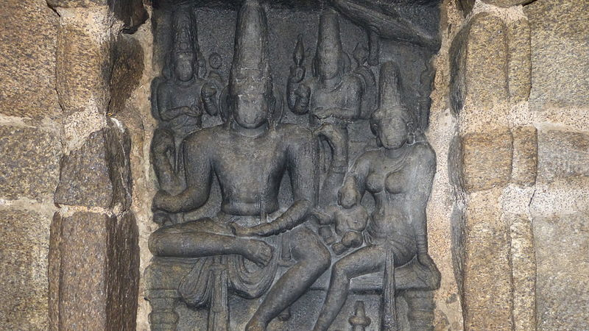
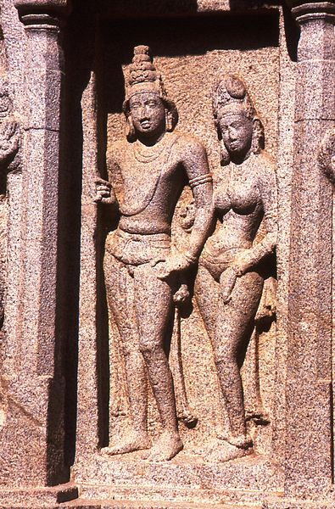

Slide 8
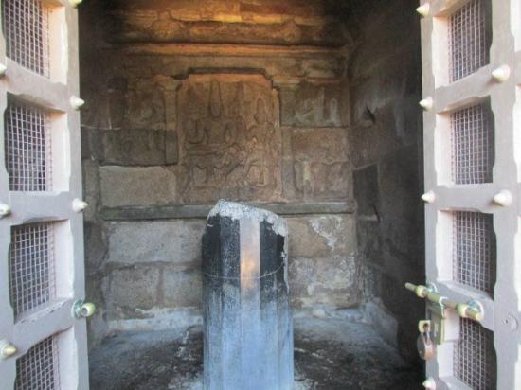
Shivalingam

Slide 9
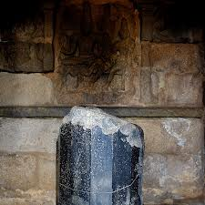
The top part of the Shivalinga figure inside the temple is found damaged.

Slide 10
There are sculptures of Somaskanda - lord Shiva with his better half, Parvati, and his sons, Skanda and Ganesha are found on the near wall.

Slide 11
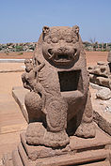
Apart from Lord Shiva’s sculpture, one can find the sculptures of Narasimha and Goddess Durgha also.

Slide 12
The central shrine is in the form of a rectangle.
It has a magnificent statue of lord Vishnu which is known as Sthala Shayana Perumal or Ananthasayana which means sleeping Vishnu.
The peculiarity about this particular temple is - Vishnu reclines on the floor listening silently the sounds of names.

Slide 13
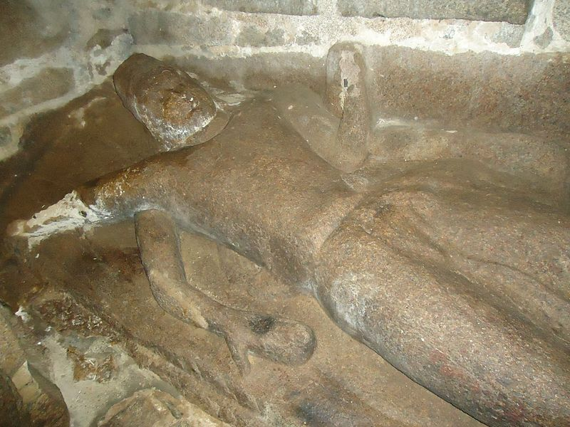

Slide 14
PICTURES OF SHORE TEMPLE

Slide 15
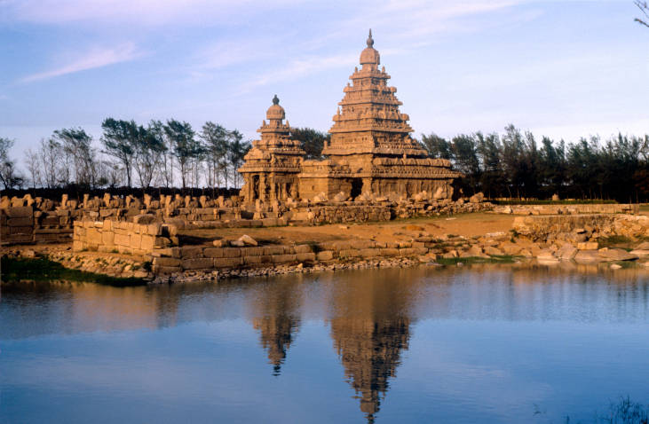

Slide 16
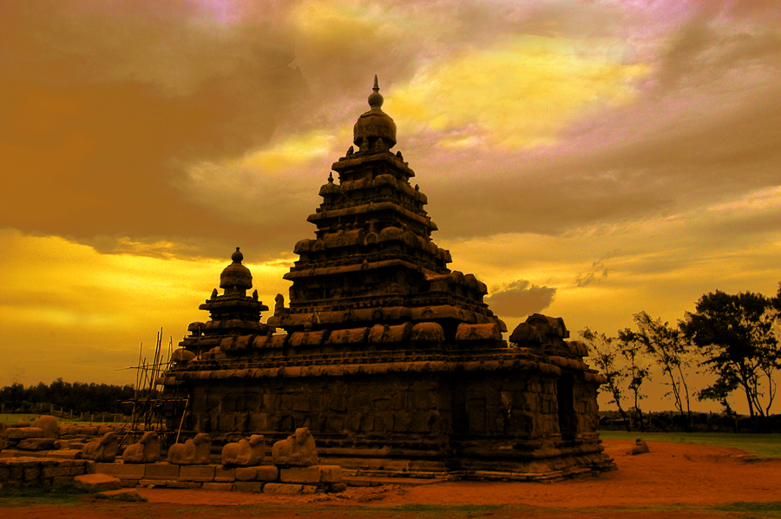

Slide 17
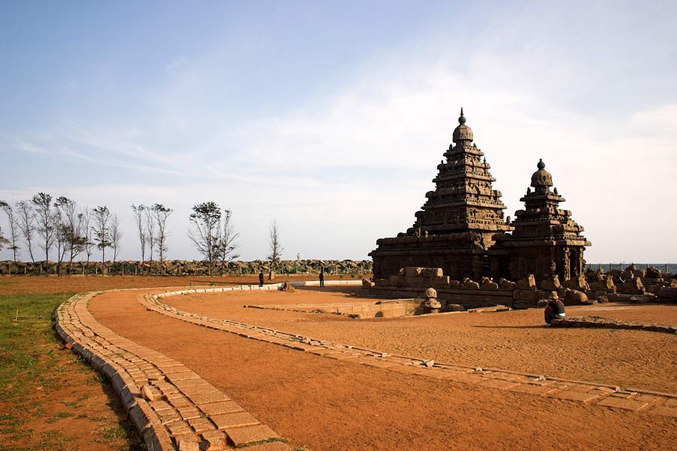

Slide 18
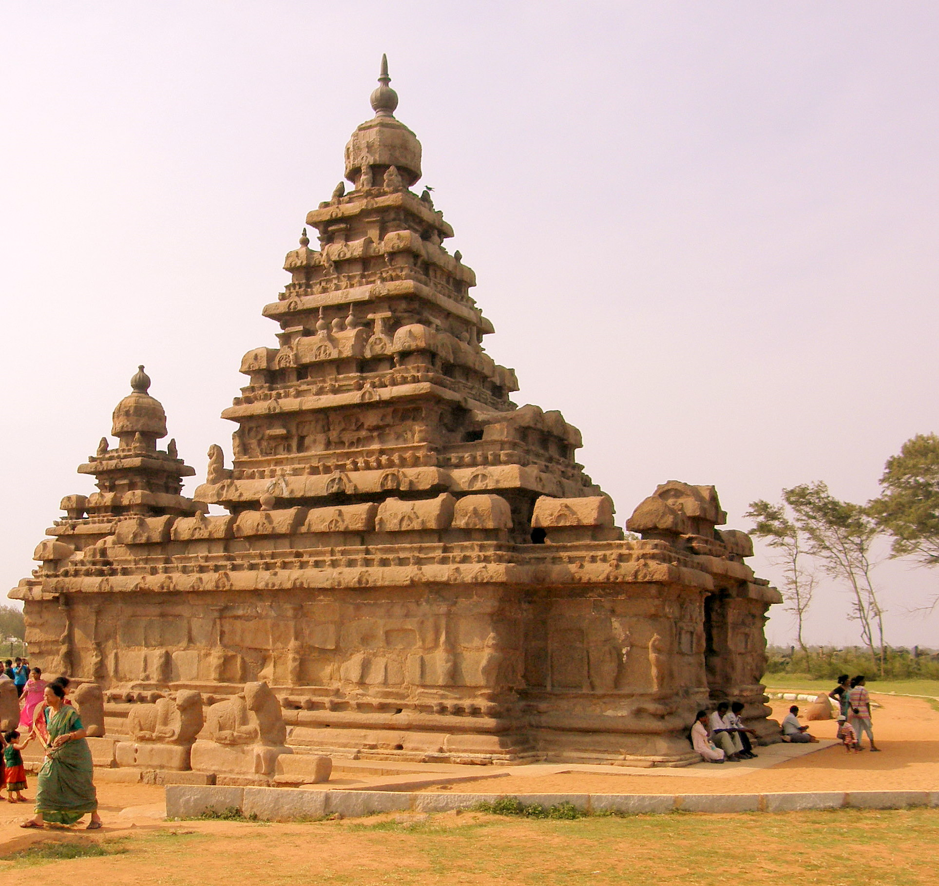

Slide 19
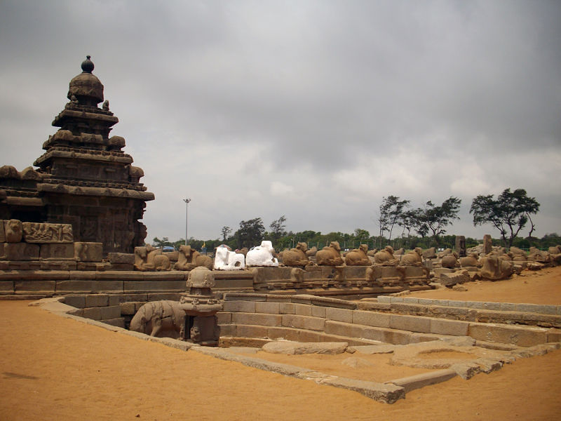

Slide 20
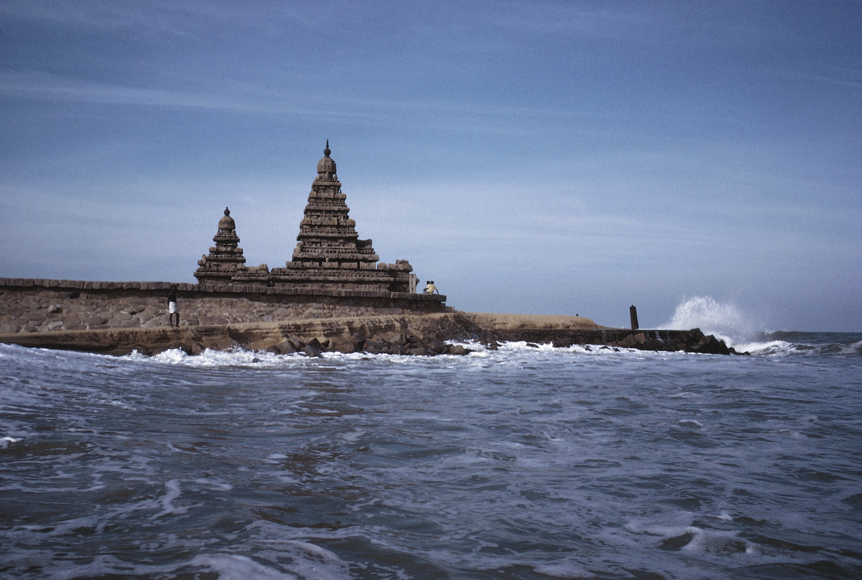

Slide 21
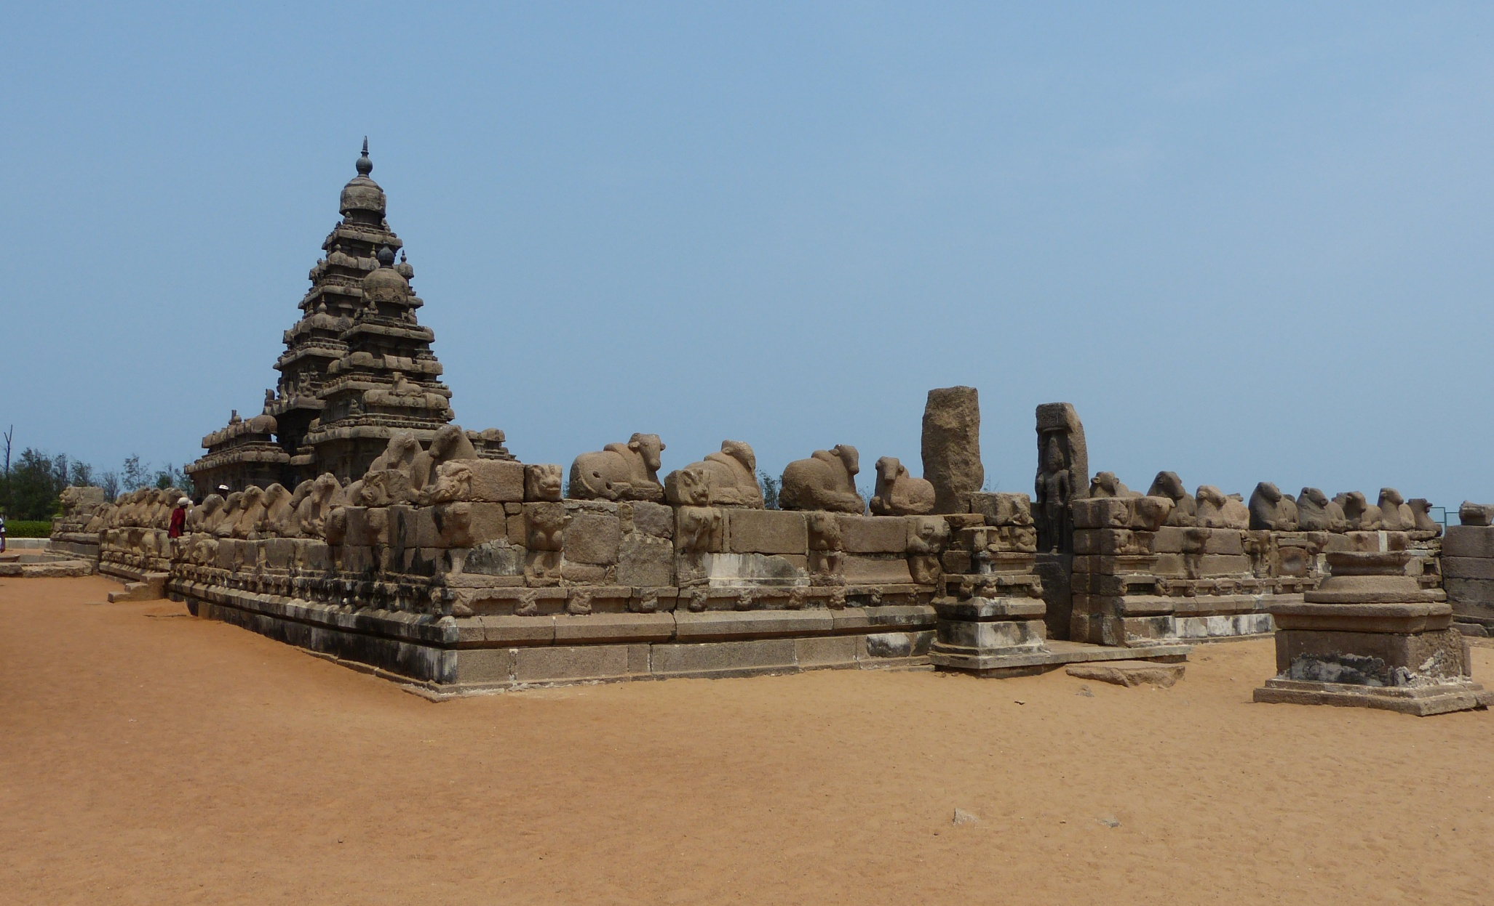

Slide 22
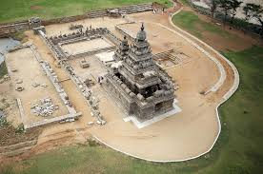
TOP VIEW

Slide 23
All the three Temples of the Shore Temple complex are built on the same platform.
from the northern end, the temples appear to be a replica of the Dharmaraja Ratha.
The main Shore Temple, which faces east so that the sun rays shine on the main deity of Shiva Linga in the shrine.
Its pyramidal structure is 60 feet (18 m) high and sits on a 50 feet (15 m) square platform. There is a small temple in front which was the original porch

Slide 24
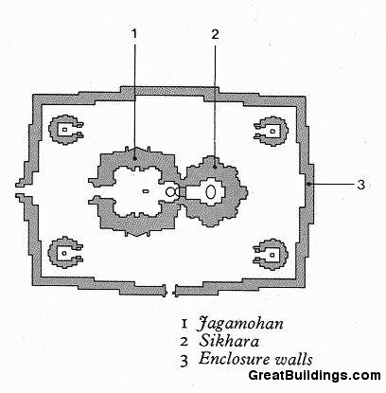
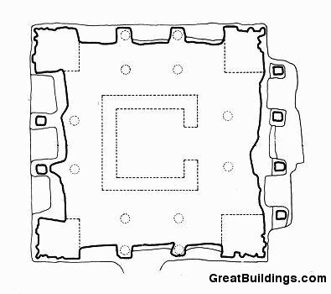
PLAN

Slide 25
The temple has a garbhagriha in which the deity, Sivalinga, is enshrined.
A small mandapa surrounded by a heavy outer wall with little space between for circumambulation.
The Durga is seated on her lion vahana. A small shrine may have been in the cavity in the lion's chest

Slide 26
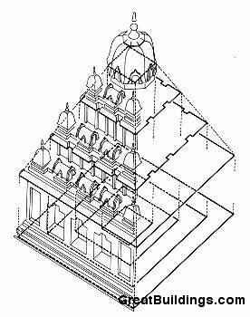
AXONOMETRIC VIEW

Slide 27
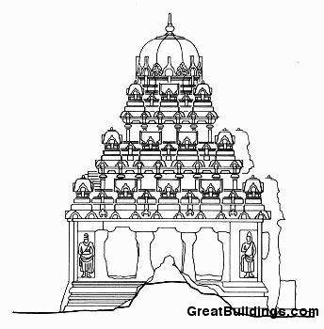
ELEVATION

Slide 28
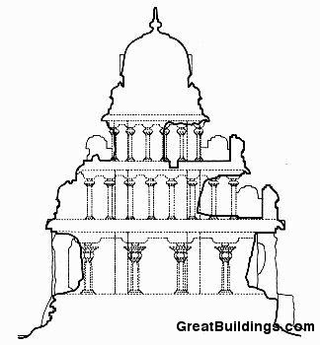
SECTION

Slide 29
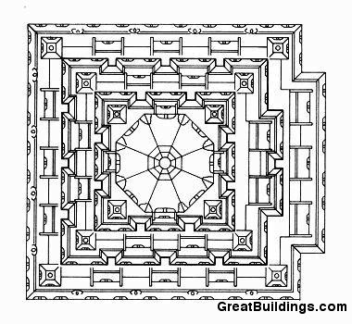
TOP VIEW

Slide 30
ENTRANCE

Slide 31
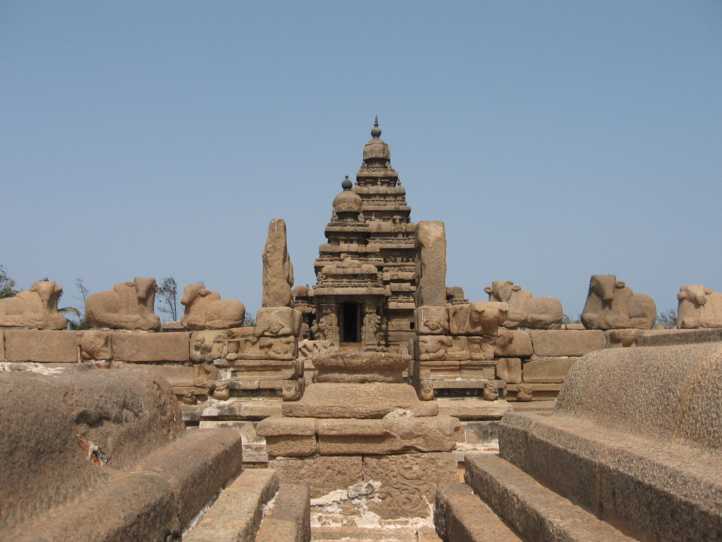

Slide 33
EARLY PICTURES

Slide 34
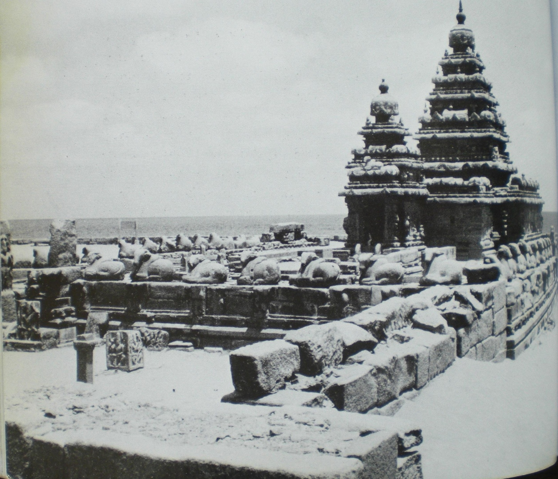

Slide 35
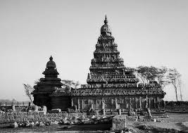
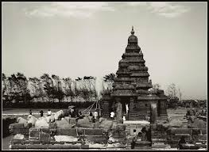

Slide 36
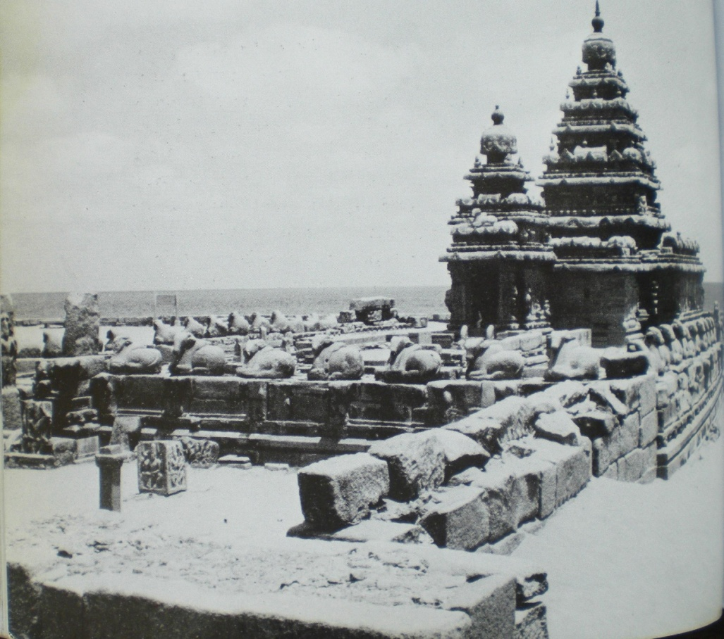
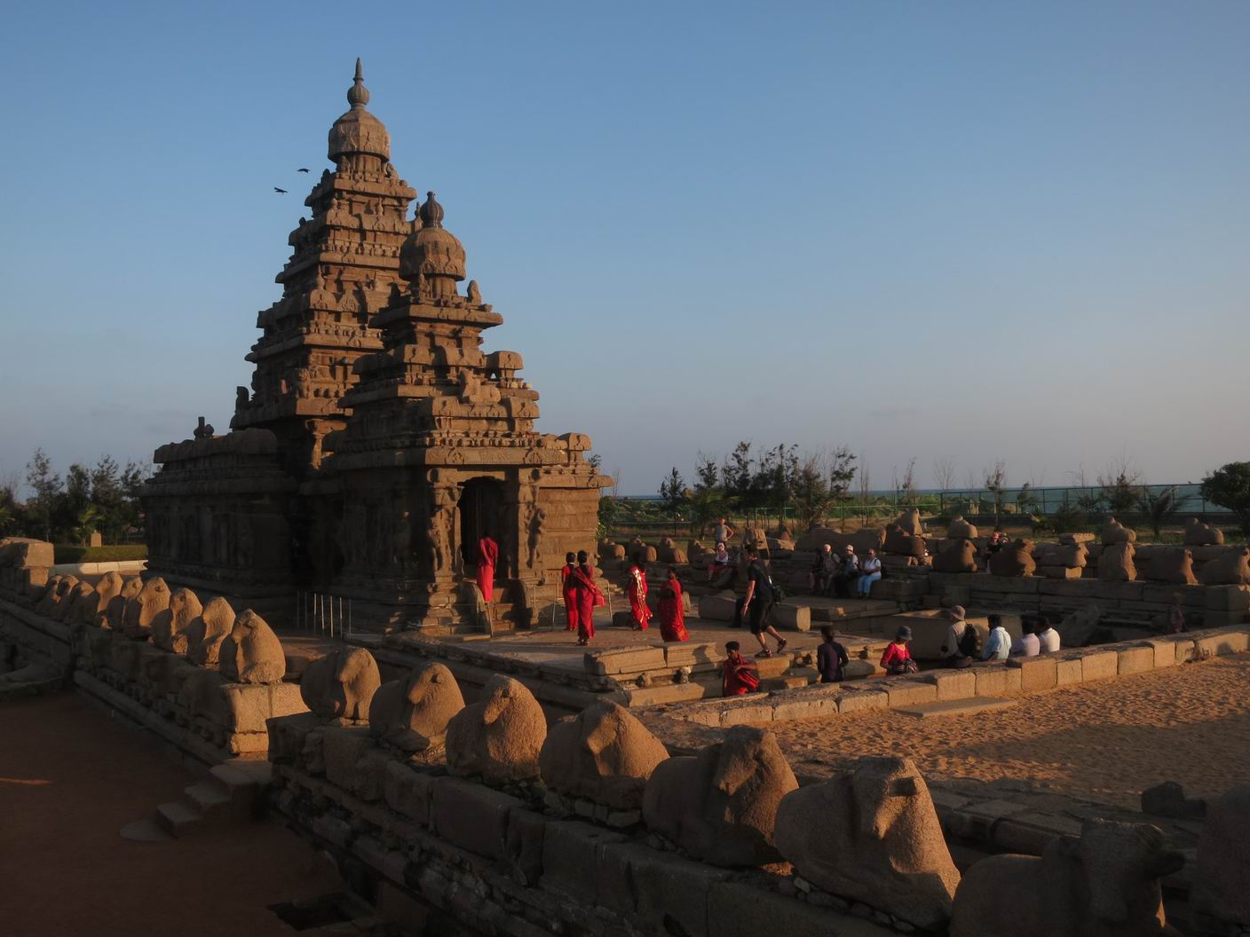
THEN AND NOW

Slide 37
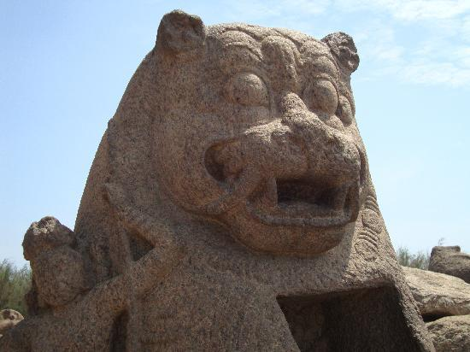

Slide 38
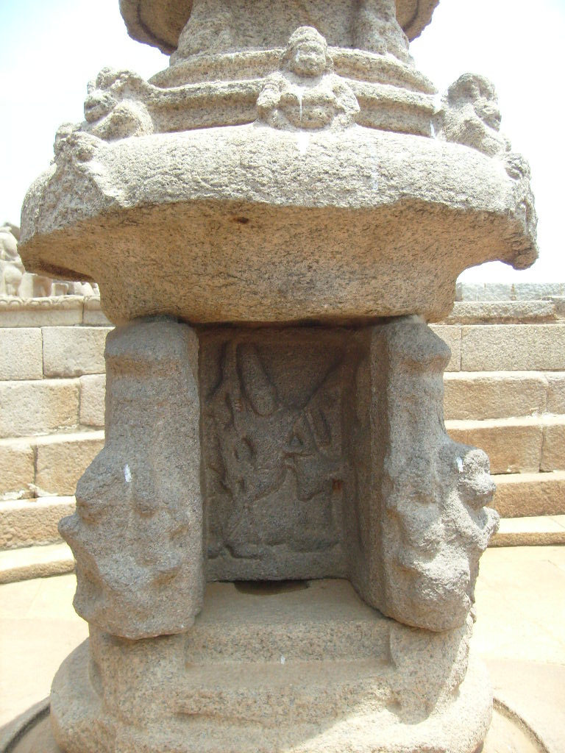
MINIATURE SHRINE

Slide 39
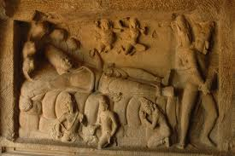

Slide 40
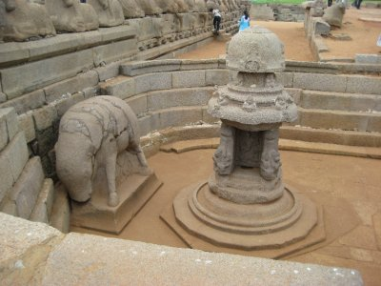
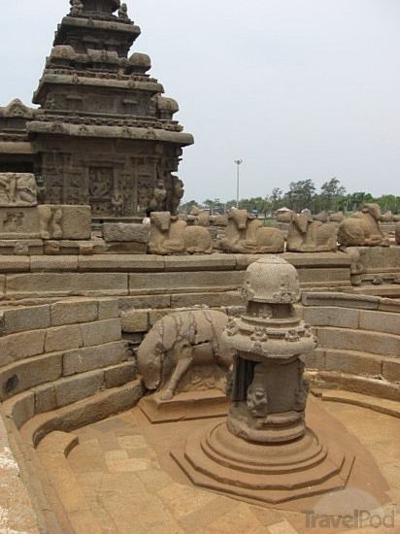

Slide 41
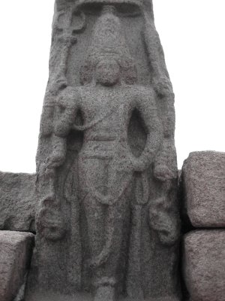

Slide 42
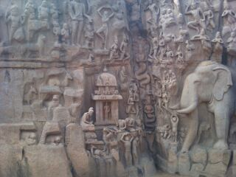

Slide 43
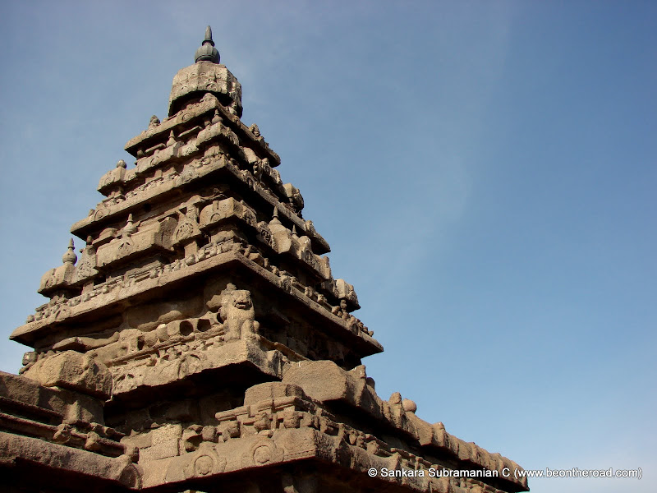
GOPURAM

Slide 44
THE END

